Slide 1
Topic Modeling and Latent Dirichlet Allocation: An Overview
Weifeng Li, Sagar Samtani and Hsinchun Chen
Acknowledgements: David Blei, Princeton University
The Stanford Natural Language Processing Group

Slide 2
Outline
Introduction and Motivation
Latent Dirichlet Allocation
Probabilistic Modeling Overview
LDA Assumptions
Inference
Evaluation
Two Examples on Applying LDA to Cyber Security Research
Profiling Underground Economy Sellers
Understanding Hacker Source Code
LDA Variants
Relaxing the Assumptions of LDA
Incorporating Metadata
Generalizing to Other Kinds of Data
Future Directions
LDA Tools

Slide 3
Outline
Introduction and Motivation
Latent Dirichlet Allocation
Probabilistic Modeling Overview
LDA Assumptions
Inference
Evaluation
Two Examples on Applying LDA to Cyber Security Research
Profiling Underground Economy Sellers
Understanding Hacker Source Code
LDA Variants
Relaxing the Assumptions of LDA
Incorporating Metadata
Generalizing to Other Kinds of Data
Future Directions
LDA Tools

Slide 4
Introduction and Motivation
As more information is becoming easily available, it is difficult to find and discover what we need.
Topic models are a suite of algorithms for discovering the main themes that pervade a large and other wise unstructured collection of documents.
Among these algorithms, Latent Dirichlet Allocation (LDA), a technique based in Bayesian Modeling, is the most commonly used nowadays.
Topic models can be applied to massive collections of documents to automatically organize, understand, search, and summarize large electronic archives.
Especially relevant in today’s “Big Data” environment.

Slide 5
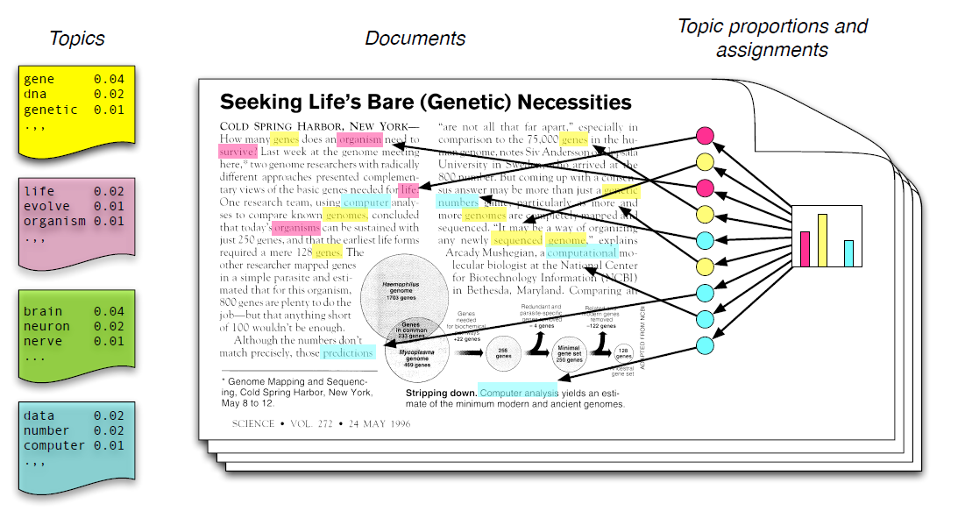
Introduction and Motivation
Each topic is a distribution of words; each document is a mixture of corpus-wide topics; and each word is drawn from one of those topics.

Slide 6
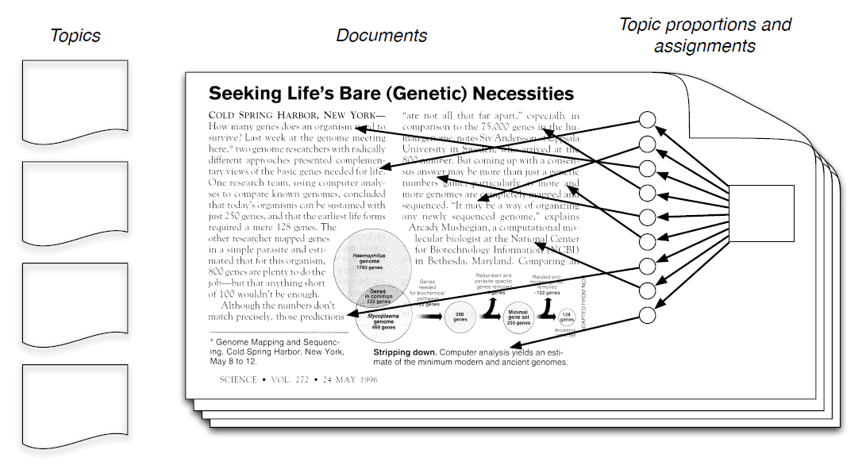
Introduction and Motivation
In reality, we only observe documents. The other structures are hidden variables. Our goal to infer the hidden variables.

Slide 7
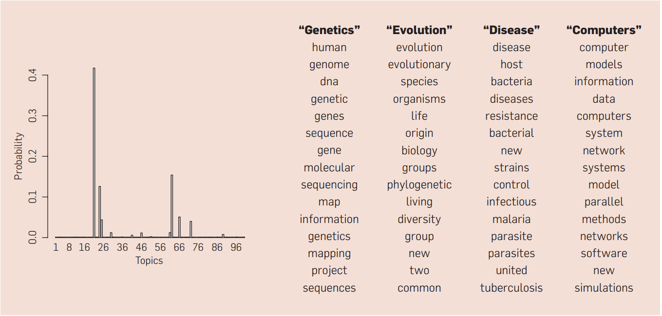
Introduction and Motivation: 100-topic LDA, 17,000 Science articles
The resulting output from an LDA model would be sets of topics containing keywords which would then be manually labeled. On the left are the inferred topic proportions for the example article from the pervious figure.

Slide 8


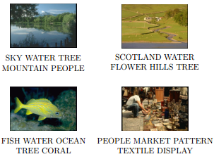
Use Cases of Topic Modeling
Topic models have been used to:
Annotate documents and images
Organize and browse large corpora
Model topic evolution
Categorize source code archives
Discover influential articles

Slide 9
Outline
Introduction and Motivation
Latent Dirichlet Allocation
Probabilistic Modeling Overview
LDA Assumptions
Inference
Evaluation
Two Examples on Applying LDA to Cyber Security Research
Profiling Underground Economy Sellers
Understanding Hacker Source Code
LDA Variants
Relaxing the Assumptions of LDA
Incorporating Metadata
Generalizing to Other Kinds of Data
Future Directions
LDA Tools

Slide 10
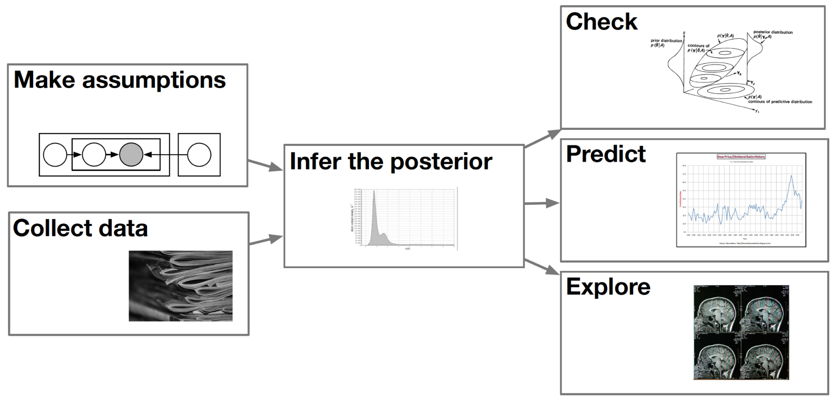
Probabilistic Modeling Overview
Modeling: treat the data as arising from a generative process that includes hidden variables. This defines a joint distribution over both the observed and the hidden variables.
Inference: infer the conditional distribution (posterior) of the hidden variables given the observed variables.
Analysis: check the fit of the model; make prediction based on new data; explore the properties of the hidden variables.
Modeling
Inference
Analysis
Notes:
Blei

Slide 11
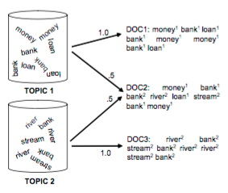
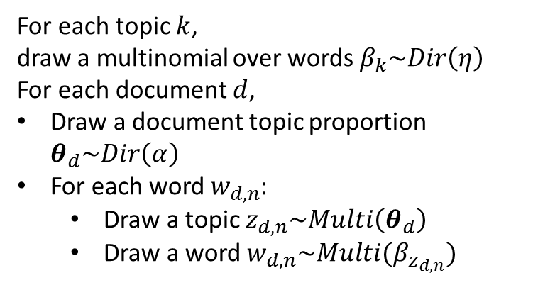
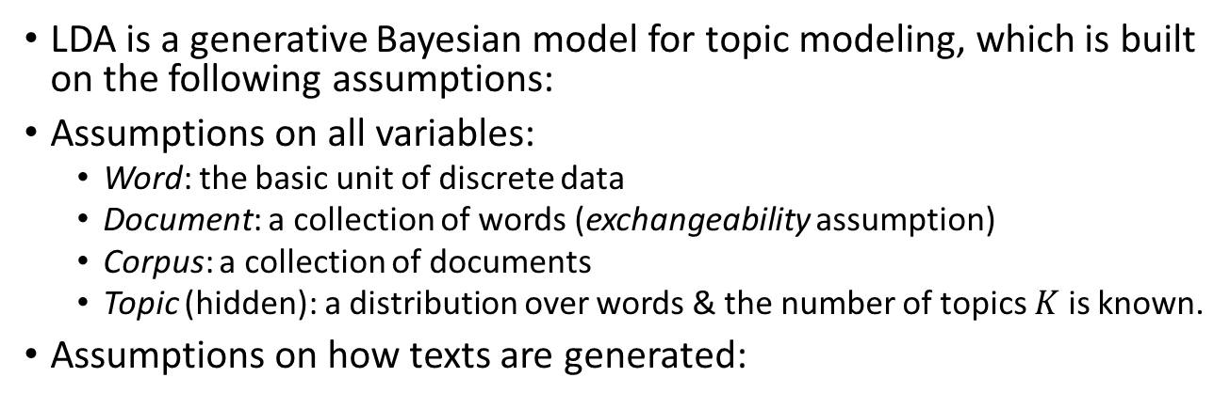
Latent Dirichlet Allocation: Assumptions
LDA is a generative Bayesian model for topic modeling, which is built on the following assumptions:
Assumptions on all variables:
Word: the basic unit of discrete data
Document: a collection of words (exchangeability assumption)
Corpus: a collection of documents
Topic (hidden): a distribution over words & the number of topics $K$ is known.
Assumptions on how texts are generated:
Dirichlet Dist. (next slide)
For each topic $k$, draw a multinomial over words $β_{k}\sim Dir\left(η\right)$
For each document $d$,
Draw a document topic proportion $θ_{d}\sim Dir\left(α\right)$
For each word $w_{d,n}$:
Draw a topic $z_{d,n}\sim Multi\left(θ_{d}\right)$
Draw a word $w_{d,n}\sim Multi(β_{z_{d,n}})$

Slide 12
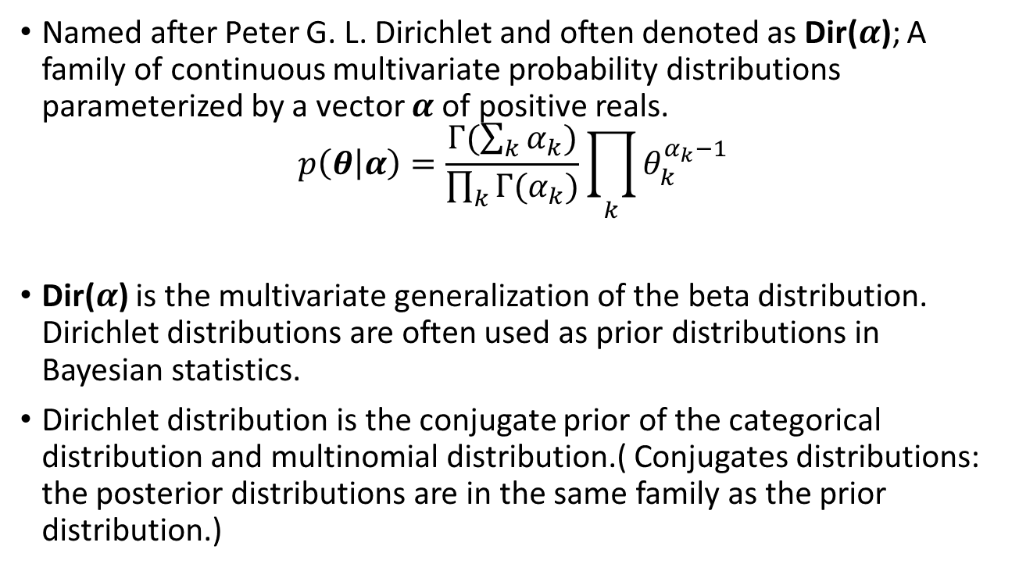

Dirichlet Distribution: Dir($α$)
Named after Peter G. L. Dirichlet and often denoted as Dir($α$); A family of continuous multivariate probability distributions parameterized by a vector $α$ of positive reals.
$$p\left(θ | α\right)=\frac{Γ(\sum_{k}{α_{k}})}{\prod_{k}{Γ(α_{k})}}\prod_{k}{θ_{k}^{α_{k}−1}}$$
Dir($α$) is the multivariate generalization of the beta distribution. Dirichlet distributions are often used as prior distributions in Bayesian statistics.
Dirichlet distribution is the conjugate prior of the categorical distribution and multinomial distribution.( Conjugates distributions: the posterior distributions are in the same family as the prior distribution.)

Slide 13
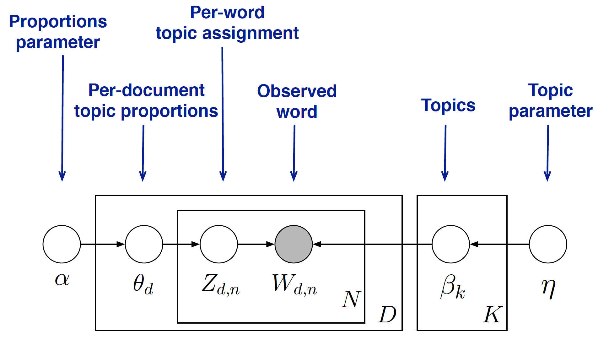
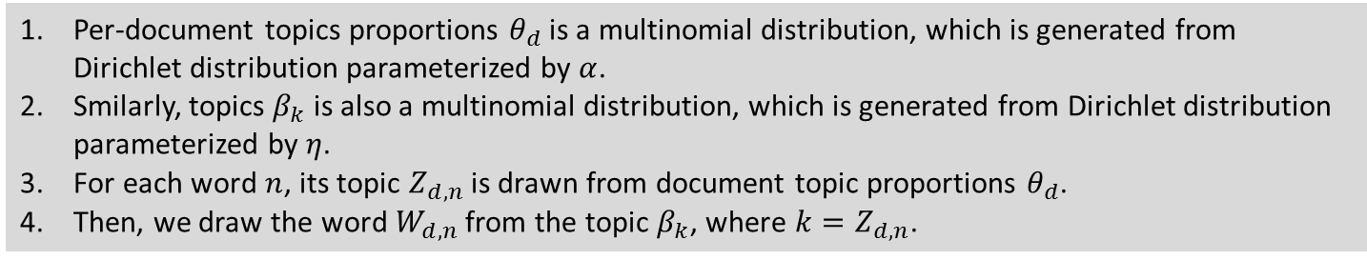
LDA: Probabilistic Graphical Model
Per-document topics proportions $θ_{d}$ is a multinomial distribution, which is generated from Dirichlet distribution parameterized by $α$.
Smilarly, topics $β_{k}$ is also a multinomial distribution, which is generated from Dirichlet distribution parameterized by $η$.
For each word $n$, its topic $Z_{d,n}$ is drawn from document topic proportions $θ_{d}$.
Then, we draw the word $W_{d,n}$ from the topic $β_{k}$, where $k=Z_{d,n}$.

Slide 14
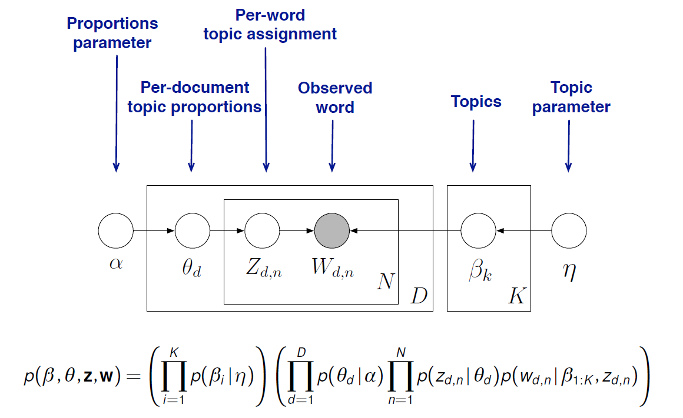
The Graphical Model for LDA: Joint Distribution
This distribution specifies a number of dependencies that define LDA (as shown in the plate diagram).

Slide 15
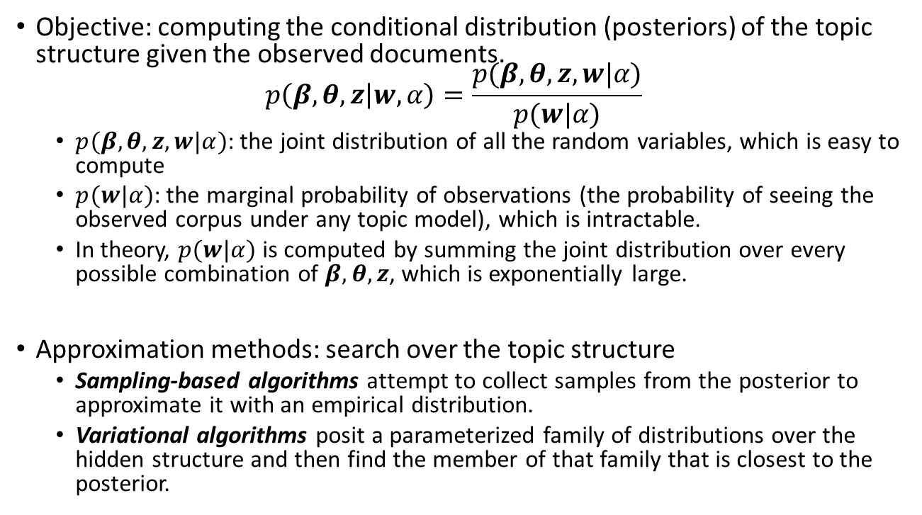
Inference
Objective: computing the conditional distribution (posteriors) of the topic structure given the observed documents. $p\left(β,θ,z | w,α\right)=\frac{p(β,θ,z,w|α)}{p(w|α)}$
$p(β,θ,z,w|α)$: the joint distribution of all the random variables, which is easy to compute
$p(w|α)$: the marginal probability of observations (the probability of seeing the observed corpus under any topic model), which is intractable.
In theory, $p(w|α)$ is computed by summing the joint distribution over every possible combination of $β,θ,z$, which is exponentially large.
Approximation methods: search over the topic structure
Sampling-based algorithms attempt to collect samples from the posterior to approximate it with an empirical distribution.
Variational algorithms posit a parameterized family of distributions over the hidden structure and then find the member of that family that is closest to the posterior.

Slide 16
More on Approximation Methods
In Sampling-based algorithms, Gibbs sampling is the most commonly used:
Approximating the posterior with samples.
Construct a Markov chain—a sequence of random variables, each dependent on the previous—whose limiting distribution is the posterior.
The Markov chain is defined on the hidden topic variables for a particular corpus, and the algorithm is to run the chain for a long time, collect samples from the limiting distribution, and then approximate the distribution with the collected samples (see Steyers & Griffiths, 2006).
Variational algorithms are a deterministic alternative to sampling-based algorithms.
Posit a parametrized family of distributions over the hidden structure and then find the member of that family that is closet to the posterior.
The inference problem is transformed to an optimization problem.
Coordinate ascent variational inference algorithm for LDA (see Blei, Ng, and Jordan, 2003)

Slide 17
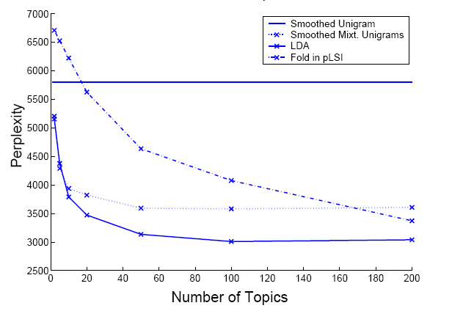
Model Evaluation: Perplexity
Perplexity is the most typical evaluation of LDA models (Bao & Datta, 2014; Blei et al., 2003).
Perplexity measures the modeling power by calculating the inverse log-likelihood of unobserved documents (an decreasing function). (Higher likelihood, the better model)
Better models have lower perplexity, suggesting less uncertainties about the unobserved document.
Average log-likelihood of all unobserved document
Log-likelihood of each unobserved document
W_{d}: words in document d;
N_{d}: Length of document d
The figure compares LDA with other topic modeling approaches. The LDA model is consistently better than all other benchmark approaches. Moreover, as the number of topics go up, the LDA model becomes better (i.e., the perplexity decreases.)

Slide 18
Model Selection: How Many Topics to Choose
The author of LDA suggests to select the number of topics from 50 to 150 (Blei 2012); however, the optimal number usually depends on the size of the dataset.
Cross validation on perplexity is often used for selecting the number of topics.
Specifically, we propose possible numbers of topics first, evaluate the average perplexity using cross validation, and pick the number of topics that has the lowest perplexity.
The following plot illustrates the selection of optimal number of topics for 4 datasets.

Slide 19
Outline
Introduction and Motivation
Latent Dirichlet Allocation
Probabilistic Modeling Overview
LDA Assumptions
Inference
Evaluation
Two Examples on Applying LDA to Cyber Security Research
Profiling Underground Economy Sellers
Understanding Hacker Source Code
LDA Variants
Relaxing the Assumptions of LDA
Incorporating Metadata
Generalizing to Other Kinds of Data
Future Directions
LDA Tools

Slide 20
Cybersecurity Research Example – Profiling Underground Economy Sellers
The underground economy is the online black market for exchanging products/services that relate to cybercrimes.
Cyber crime activities have been mostly commoditized in the underground economy. → Sellers impose a growing threat to cyber security.
Sellers advertise their products/services by giving details about their resources, payments, contacts, etc.
Objective: to profile underground economy sellers to reflect their specialties(characteristics)

Slide 21
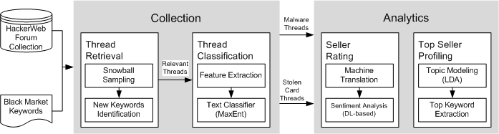
Cybersecurity Research Example – Profiling Underground Economy Sellers
Input: Original threads from hacker forums
Preprocessing:
Thread Retrieval: Identifying threads related to the underground economy by conducting snowball sampling-based keywords search
Thread Classification: Identifying advertisement threads using MaxEnt classifier
Focusing on malware advertisements and stolen card advertisement
Can be generalized to other advertisements.

Slide 22
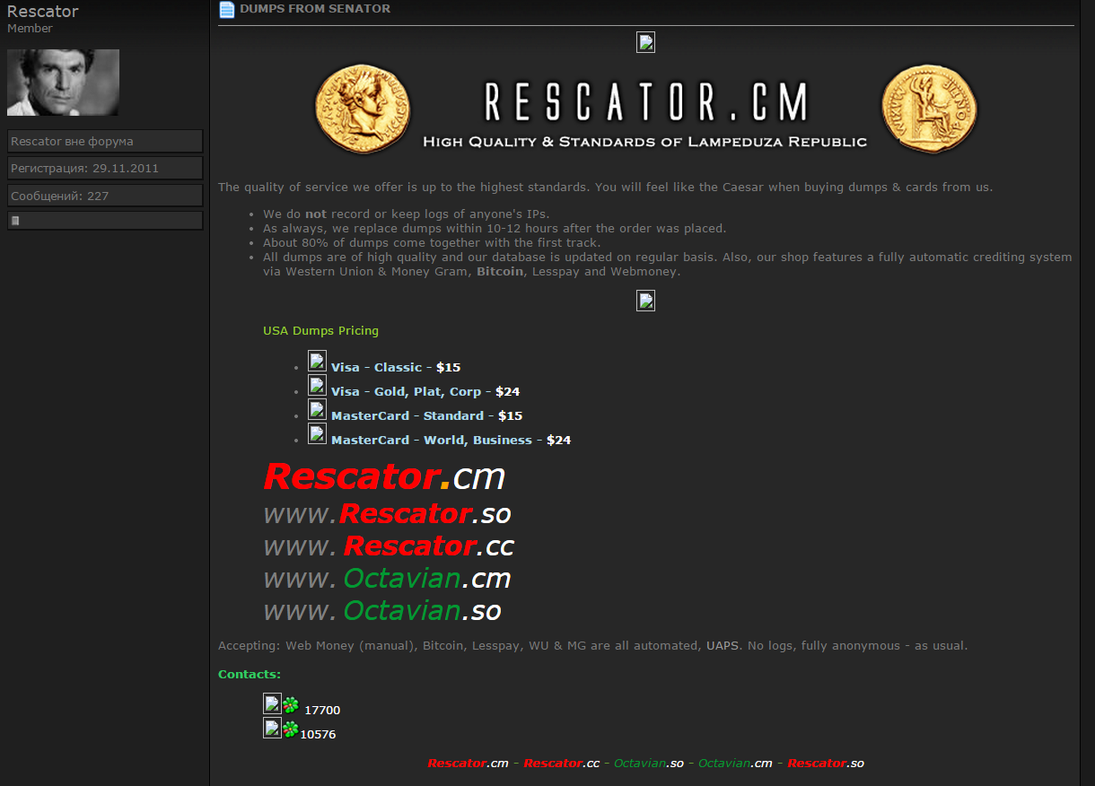
Cybersecurity Research Example – Profiling Underground Economy Sellers
To profile the seller, we seek to identify the major topics in its advertisement.
Example input:
Description of the stolen data/service
Seller of stolen data: Rescator
Prices of the stolen data
Contact: a dedicated shop and ICQ
Payment Options
22

Slide 23
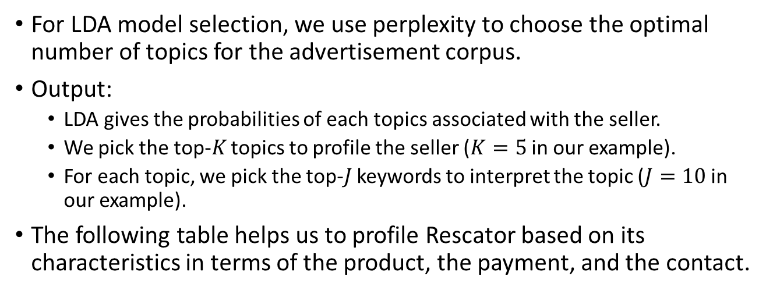
Cybersecurity Research Example – Profiling Underground Economy Sellers
For LDA model selection, we use perplexity to choose the optimal number of topics for the advertisement corpus.
Output:
LDA gives the probabilities of each topics associated with the seller.
We pick the top-$K$ topics to profile the seller ($K=5$ in our example).
For each topic, we pick the top-$J$ keywords to interpret the topic ($J=10$ in our example).
The following table helps us to profile Rescator based on its characteristics in terms of the product, the payment, and the contact.
Top Seller Characteristics of Rescator
# | Top Keywords | Interpretation
5 | shop, wmz, icq, webmoney, price, dump, | Product: CCs, dumps (valid, verified); Payment: wmz, webmoney, bitcoin, lesspay; Contact: shop, register, deposit, email, icq, jabber
6 | валид(valid), чекер(checker), карты(cards), баланс(balance), карт(cards)
8 | shop, good, CCs, bases, update, cards, bitcoin, webmoney, validity, lesspay
11 | dollars, dumps, deposit, payment, sell, online, verified
16 | email, shop, register, icq, account, jabber,

Slide 24
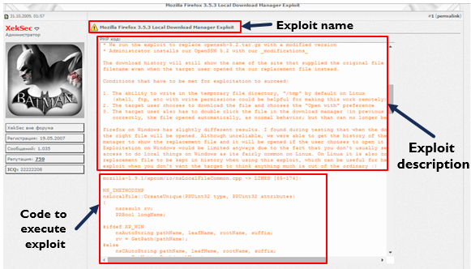
Cybersecurity Research Example – Understanding Hacker Source Code
Underground hacker forums provide a unique platform to understand assets which may be used for a cyber-attack.
Hacker source code is one of the more abundant cyber-assets in such communities.
There are often tens of thousands of such snippets of code embedded in forum postings.
However, little research has attempted to automatically understand such assets.
Such research can lead to better cyber-defenses and also potential reuse of such assets for educational purposes.

Slide 25
Cybersecurity Research Example – Understanding Hacker Source Code
LDA can help us to better understand the types of malicious source code assets which are available in such forums.
To perform the analysis, all source code post within a given forum represents a corpus which the LDA model is run on.
Associated metadata (e.g., post date, author name) are preserved for post LDA analysis.
Stanford Topic Modeling Toolbox (TMT) is used to run LDA on the source code forum postings.

Slide 26
Cybersecurity Research Example – Understanding Hacker Source Code
To identify the optimal number of topics to run for in each forum, perplexity charts are calculated.
The topic number which has the lowest perplexity score generally signifies the optimal number of topics.
However, further manual evaluation is often needed.
Data | Optimal Topic Number | Perplexity
DamageLab | 60 | 440.772
Exploit | 65 | 1,424.834
OpenSC | 95 | 4,866.838
Prologic | 95 | 970.41
Reverse4You | 80 | 1,576.980
Xakepok | 90 | 390.453
Xeksec | 80 | 1,198.133

Slide 27
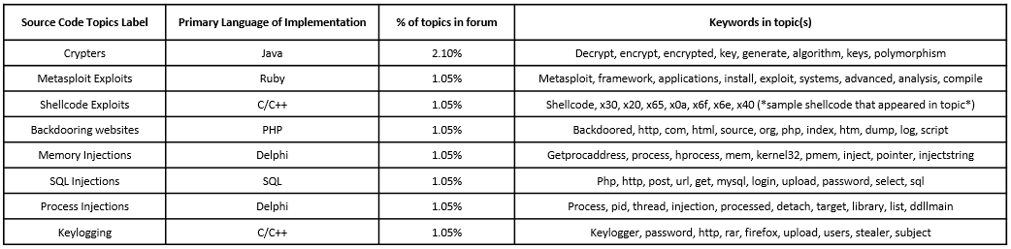
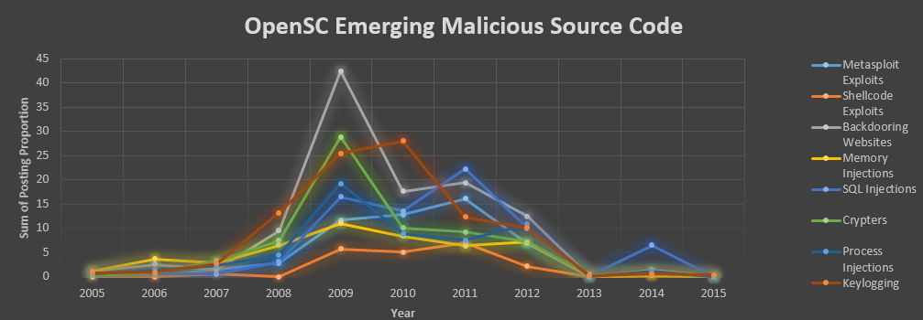
Cybersecurity Research Example – Understanding Hacker Source Code
After running the model for the optimal number of topics, we can evaluate the outputted keywords, and label each topic.
We can further analyze the results by using the associated metadata to create temporal trends, allowing us to discover interesting insights.
E.g., SQL injections in hacker forums were popular in 2009, a time which many companies were worried about website backdooring.
Overall, LDA allows researchers to automatically understand large amounts of hacker code and how specific types of code trend over time.
Reduces the need for manual explorations, and also shows the emerging exploits available in forums.

Slide 28
Outline
Introduction and Motivation
Latent Dirichlet Allocation
Probabilistic Modeling Overview
LDA Assumptions
Inference
Evaluation
Two Examples on Applying LDA to Cyber Security Research
Profiling Underground Economy Sellers
Understanding Hacker Source Code
LDA Variants
Relaxing the Assumptions of LDA
Incorporating Metadata
Generalizing to Other Kinds of Data
Future Directions
LDA Tools

Slide 29
LDA Variants: Relaxing the Assumptions of LDA
Consider the order of the words: words in a document cannot be exchanged
Conditioning on the previous word (Wallach 2006)
Hidden Markov Model (Griffiths et al. 2005)
Consider the order of the documents
Dynamic LDA (Blei & Lafferty 2006)
Consider previously unseen topics: the number of topics is not fixed
Bayesian Nonparametrics (Blei et al. 2010)

Slide 30
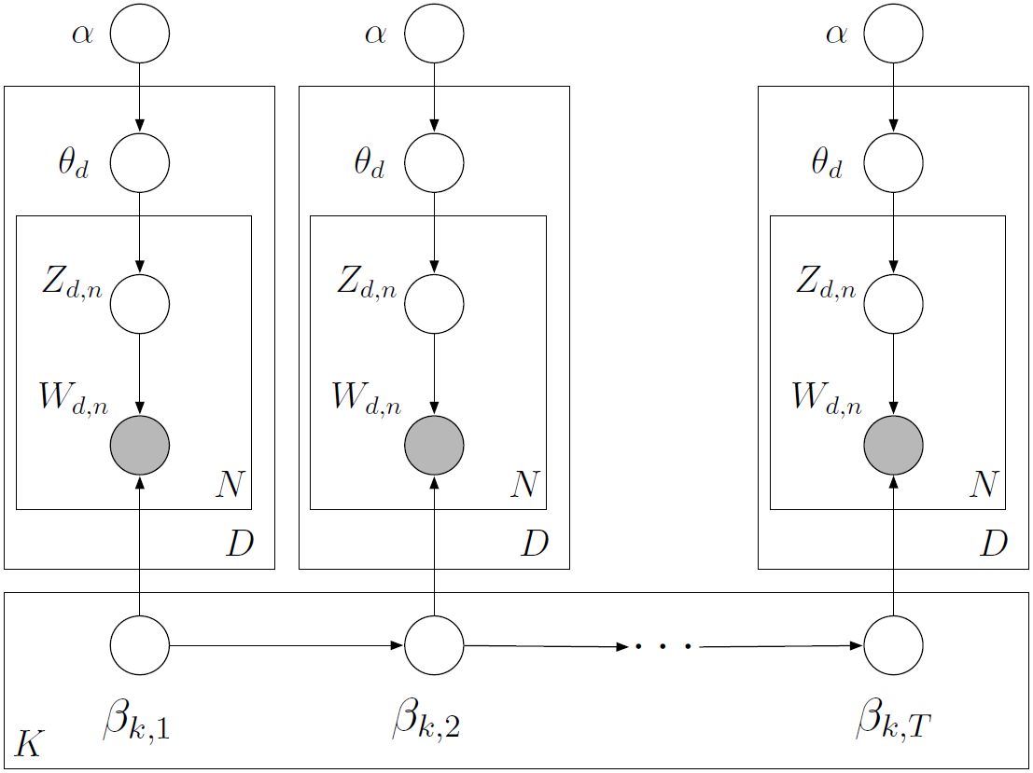
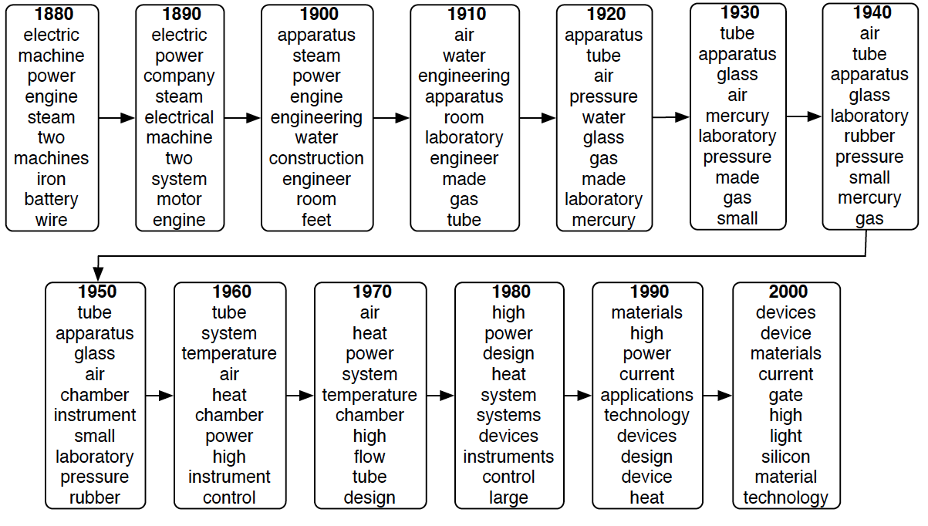
Dynamic LDA
Motivation:
LDA assumes the order of documents does not matter (Not appropriate for sequential corpora)
We want to capture language change over time.
In Dynamic LDA, topic evolves over time.
Dynamic LDA uses a logistic normal distribution to model topics evolving over time.
Example:
Topics drift through time
Blei, D. M., and Lafferty, J. D. 2006. “Dynamic topic models,” in Proceedings of the 23rd international conference on Machine learning (ICML 2006), pp. 113–120 (doi: 10.1145/1143844.1143859).

Slide 31
LDA Variants: Incorporating Metadata
Account for metadata of the documents (e.g., author, title, geographic location, links, etc.)
Author-topic model (Rosen-Zvi et al. 2004)
Assumption: The topic proportions are attached to authors.
Allows for inferences about authors, for example, author similarity.
Relational topic model (Chang & Blei 2010)
Documents are linked (e.g., citation, hyperlink)
Assumption: links between documents depend on the distance between their topic proportions.
Takes into account node attributes (the words of the document) in modeling the network links.
Supervised topic model (Blei & McAuliffe 2007)
A general purpose method for incorporating metadata into topic models

Slide 32
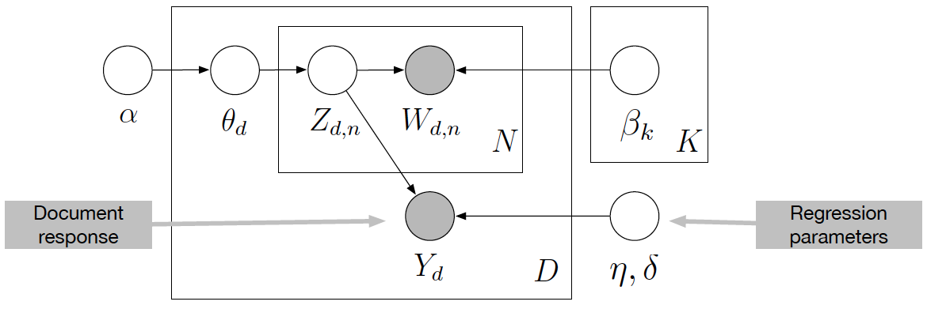
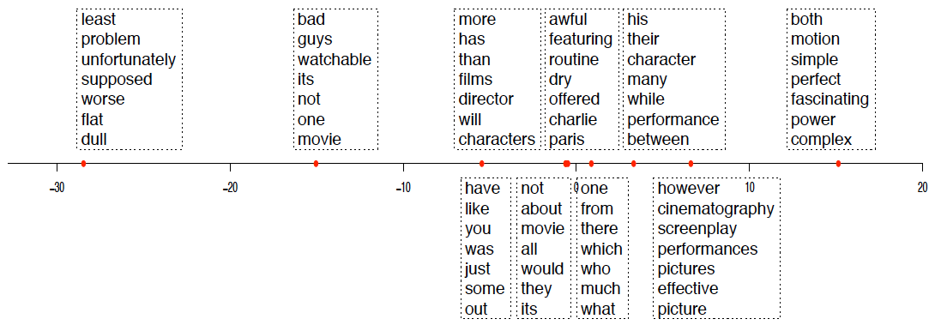
Supervised LDA
Supervised LDA are topic models of documents and response variables. They are fit to find topics predictive of the response variable.
rating
10-topic sLDA model on movie reviews (Pang and Lee, 2005): identifying the topics correspond to ratings
Blei, D. M., and Mcauliffe, J. D. 2008. “Supervised Topic Models,” in Advances in neural information processing systems, pp. 121–128 (doi: 10.1002/asmb.540).

Slide 33
LDA Variants: Generalizing to Other Kinds of Data
LDA is mixed-membership model of grouped data.
Rather than associating each group of data with one topic, each group exhibits multiple topics in different proportions.
Hence, LDA can be adapted to other kinds of observations with only small changes to the corresponding inference algorithms.
Population genetics
Application: finding ancestral populations
Intuition: each individual’s genotype descends from one or more of the ancestral populations (topics)
Computer vision
Application: classifying images, connect images and captions, build image hierarchies, etc.
Intuition: each image exhibits a combination of visual patterns and that the same visual patterns recur throughout a collection of images

Slide 34
Outline
Introduction and Motivation
Latent Dirichlet Allocation
Probabilistic Modeling Overview
LDA Assumptions
Inference
Evaluation
Two Examples on Applying LDA to Cyber Security Research
Profiling Underground Economy Sellers
Understanding Hacker Source Code
LDA Variants
Relaxing the Assumptions of LDA
Incorporating Metadata
Generalizing to Other Kinds of Data
Future Directions
LDA Tools

Slide 35
Future Directions
Evaluation and model checking
Held-out accuracy may not correspond to better organization or easier interpretation (Amazon Mechanical Turk experiment; see Chang et al., 2009; perplexity is not strongly correlated to human judgement; sometimes even slightly anti-correlated)
Which topic model should I use?
How can I decide which of the many modeling assumptions are important for my goals?
Visualization and user interfaces
How to display the topics?
How to best display a document with a topic model?
How can we best display document connections?
Topic models for data discovery
How can topic models help us form hypothesis about the data?
What can we learn about the language based on the topic model posterior?

Slide 36
Outline
Introduction and Motivation
Latent Dirichlet Allocation
Probabilistic Modeling Overview
LDA Assumptions
Inference
Evaluation
Two Examples on Applying LDA to Cyber Security Research
Profiling Underground Economy Sellers
Understanding Hacker Source Code
LDA Variants
Relaxing the Assumptions of LDA
Incorporating Metadata
Generalizing to Other Kinds of Data
Future Directions
LDA Tools

Slide 37
Topic Modeling - Tools
Name | Model/Algorithm | Language | Author | Notes
lda-c | Latent Dirichlet allocation | C | D. Blei | This implements variational inference for LDA.
class-slda | Supervised topic models for classification | C++ | C. Wang | Implements supervised topic models with a categorical response.
lda | R package for Gibbs sampling in many models | R | J. Chang | Implements many models and is fast . Supports LDA, RTMs (for networked documents), MMSB (for network data), and sLDA (with a continuous response).
tmve | Topic Model Visualization Engine | Python | A. Chaney | A package for creating corpus browsers.
dtm | Dynamic topic models and the influence model | C++ | S. Gerrish | This implements topics that change over time and a model of how individual documents predict that change.
ctm-c | Correlated topic models | C | D. Blei | This implements variational inference for the CTM.
Mallet | LDA, Hierarchical LDA | Java | A. McCallum | Implements LDA and Hierarchical LDA
Stanford topic modeling toolbox | LDA, Labeled LDA, Partially Labeled LDA | Java | Stanford NLP Group | Implements LDA, Labeled LDA, and PLDA

